Slide 1

ZILLOW GROUP SMARKETING RECOMMENDATIONS Data-cated
Eirik Fosnaes
Jillian Pflugrath
Nancy Jain
Yifan Xiang
Ziyu Jin

Slide 2
Agenda
Data Insights
Future Analysis
Lead Attribution
ROI
Recommendations

Slide 3
RECOMMENDATIONS
Research sources of organic leads
Reduce the average number of calls to acquire a lead
Increase email
Increase meetings
Slightly decrease social
Notes:
Research sources of organic leads
Reduce the average number of calls needed to acquire a lead – by that also reduce the cost of that channel
Use email more

Slide 4
ATTRIBUTION: evenly distributing credit across all touch points
was
last-touch attribution
now
linear multi-touch attribution
Notes:
The linear model values each touchpoint as equal by evenly distributing credit across all touchpoints in the user’s path to conversion.
it only looks at frequency and does not take other factors, such as recency, into consideration
The previous model used was last-touch attribution. Only assigning credit to the last touch before a lead is acquired
Our attribution model evenly distributeds credit across all touch points from before a lead is acquired

Slide 5
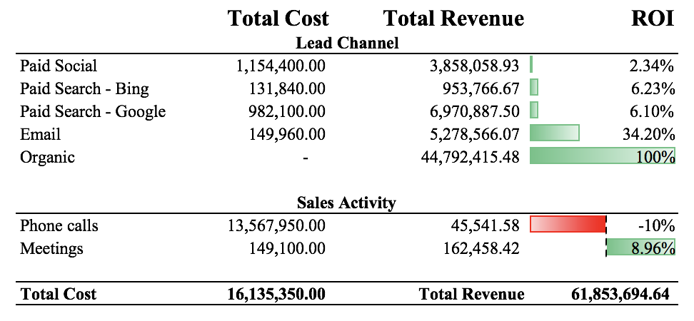
ROI

Slide 6
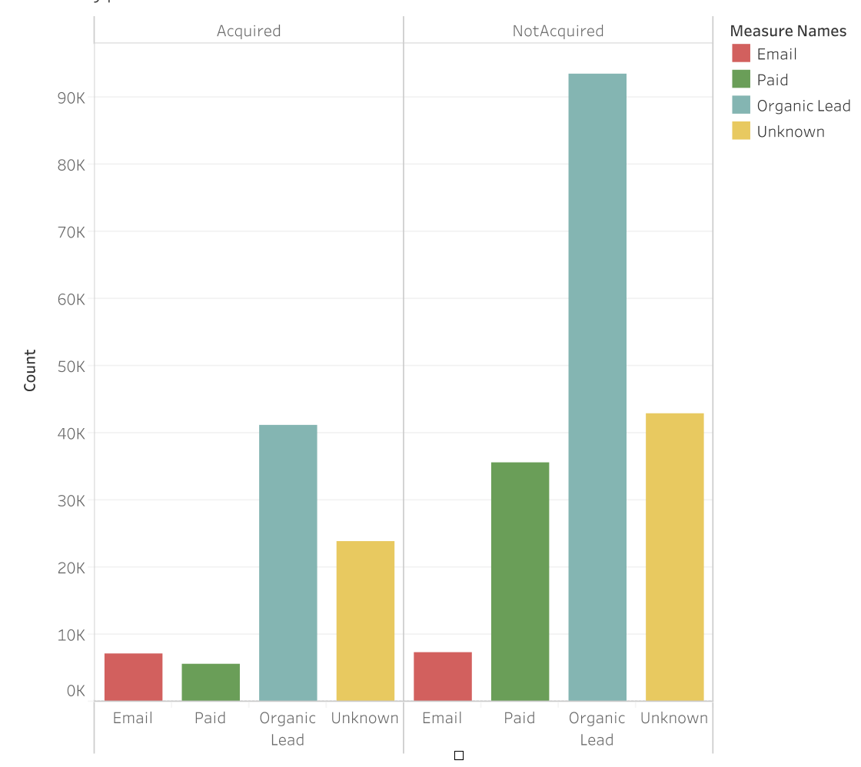
Lead Type majority of leads are organic
Application:
research sources of "organic" leads
Notes:
Impressions
conventions

Slide 7
Lead Vendor – Conversion Rate
Vendor | Percent Acquired
Google | 11.82%
Organic | 10.20%
Bing | 9.51%
Social | 8.56%
Email | 5.73%
Other | 1.31%

Slide 8
Number of Meetings of leads who had meetings, 13% were acquired
109
716
Notes:
Even though it seems like meetings has a bad return, but it is important to give a custom and personal approach to some customers that might not be as comfortable committing
to anything online or over the phone. If one meeting is all it takes to acquire a customer, then the price of $300 is well worth it given the current 2 year NPV of a acquired customer.
Without knowing more about these people other studies have shown that a personal touch often means a greater customer retention that will be valuable for many more years than the
2 years.

Slide 9
Average Number of Phone Calls 9 calls on average per acquired lead
Median phone call duration
Acquired leads: 5 minutes
Non-acquired leads: 1 minute
Application:
reduce the number calls it takes to acquire a lead
Notes:
Ways of reducing the number of call:
When people fill out the form and become leads have the form include preferred method to be contacted initially – text message, email, phone call
If they want a phone call include preferred time to be contacted. Email especially have proven to be effective and not reason not to explore that option more
We found the Average phone call duration per lead and then found the median duration of all leads
Median duration phone call conversation for an acquired customer is 5 minutes and the median duration for non acquired is around 1 minute

Slide 10
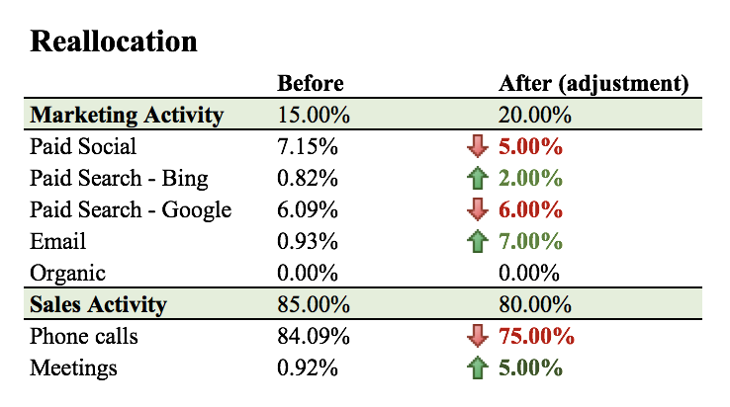
RECOMMENDATIONS

Slide 11
FUTURE ANALYSIS:
Use custom/algorithmic multi-touch attribution
Analyze time from lead to conversion
Understand different types of leads
Research and analyze organic leads
Notes:
While a linear attribution model (our attribution) does take into account every touch—it is the least sophisticated multi-touch attribution model and can
The linear attribution model is the least sophisticated of the multi-channel attribution models as it only looks at frequency and does not take key factors, such as recency, into consideration. By considering each touchpoint as equal, you run the risk of overspending in underperforming or duplicate marketing channels. While the linear model is the least recommended multi-touch model, if utilized it is best suited for B2B environments with long sales cycles.
Custom/algorithmic / data-driven
To create a model specific to your business needs can be beneficial; but this approach requires the organization to have a great understanding of their business and industry. This model utilizes a Google Analytics model as a baseline (time decay, position based) based on an analysis of which touchpoints are driving conversions for the business. The custom model will also take typical latency patterns and site engagement into consideration.
Analyze time from lead to conversion—are any consistent pain points in the acquisition process
Are there different types of leads that will have different acquisition paths or are more responsive to different channels.
Investigating what’s contributing to organic lead /
- try to understand word of mouth
-analyze changes in time of organic traffic to see if it is correlates with any other events
-conduct survey of current premier agents who were categorized as organic
learn how they got to Zillow and also get feedback on their experience as a premier agent
-involvement with networks of real estate agents
-conduct survey at real-estate conventions

Slide 12
Q & A

